Slide 1

Application of Machine Learning in Air Pollution Prediction
Chen ZhuoFan (P2100746)
DAAA/FT/2A/04
6 June 2022

Slide 2
Problem Background
Data Exploration
Methodology
Optimization
Conclusion
Content

Slide 3


Problem Background
Air pollution is contamination of the indoor or outdoor environment by any chemical, physical or biological agent that modifies the natural characteristics of the atmosphere.
There is suggestive evidence that many diseases are highly associated with air pollution. These diseases include stroke, ischaemic heart disease, and etc.
Moreover, air pollution can cause a large impact to the environment. Air pollution can accelerate the presence of greenhouse effect leading to more extreme weather effect and climate.
Hence, mitigating the effect of air pollution becomes especially crucial. However, reducing air pollution is a long-term effort .Countries need to set a suitable target every few years to keep track of consumption.
In this situation, forecasting could be used to predict the future trend. The obtained result can then be used to carried out calculations and be set as the target for the country.
In this experiment, we will attempt to use machine learning and evaluate a forecasting model that has the highest performance in predicting the pollution gases over an interval.

Slide 4
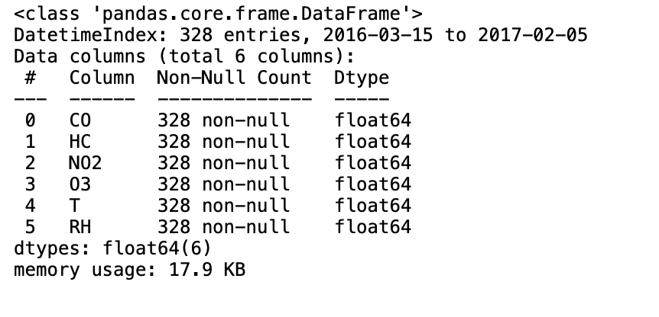
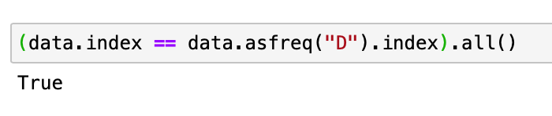
Problem Background
The dataset used in the experiment was the “Air Pollution Forecasting Dataset” retrieved from the Kaggle Data Science Community.
The dataset consist of a total of 6 attributes, 4 of the attributes are gases that needs to be forecasted.
The dataset compound of records from 15 March 2016 to 05 February 2017 .
There is a total of 328 days of records in daily frequency
The attributes of the datasets are demonstrated in the figure below.
No. | Attributes | Value
1 | Carbon Monoxide (CO) | Float number
2 | Hydrocarbon (HC) | Float number
3 | Nitrogen Oxide (NO2) | Float number
4 | Ozone (O3) | Float number
5 | Temperature (T) | Float number
6 | Relative Humidity (RH) | Float number

Slide 5
Data Exploration
Invalid Data
In the dataset , we observed several readings of gases and other attributes that is impossible to exist.
These appearance of invalid data that can be due to several reason such as extreme weather environment that cause the failure of sensor.
Missing Data
There seems to have no missing data in dataset.
Anomaly Detection
In the experiment, we utilize the Exponential Weighted Moving Average (EMVA) to carry out anomaly detection.
Several anomalies was discovered.
Most anomalies tend to be common throughout the gases, relative humidity and temperature.
Distribution
We observed that the CO , HC and O3 gases seems to be negatively skewed.
The NO2 seems to be normal distributed.

Slide 6
Data Exploration
STL Decomposition
The STL decomposition is robust to outliers and allows for the seasonal component to varies.
We found out that the seasonal period of the gases seems to be weekly.
The seasonality for all gases seems to be inconsistent which may imply a multiplicative seasonality.
The trend for gases seems non-linear.
Strength of Seasonality
We observed that the strength of seasonality is very weak.
All components have a seasonality less than 0.15.
Since the trend of seasonality for all gases are below 0.64, no seasonal differencing is recommended.
Strength of Trend
The strength of trend for the gases was relatively weak.
Gases have a trend strength of less than 0.30.

Slide 7
Data Exploration
Granger’s Causality Test
We tested whether the temperature and relative humidity is useful in forecasting the gases using the Granger’s Causality Test.
We observed that the temperature and relative humidity is useful in predicting O3 and HC.
For CO and NO2 , H0 is not rejected and therefore ,it cannot be confirmed that whether the temperature and relative humidity it is useful in forecasting.
Unit Root Test and Stationary Test
We tested unit root and trend-stationary using the ADF test and KPSS test respectively.
All the gases rejected H0 in ADF test and did not reject H0 in KPSS test.
This implies that all gases are stationary.

Slide 8
Methodology

Slide 9
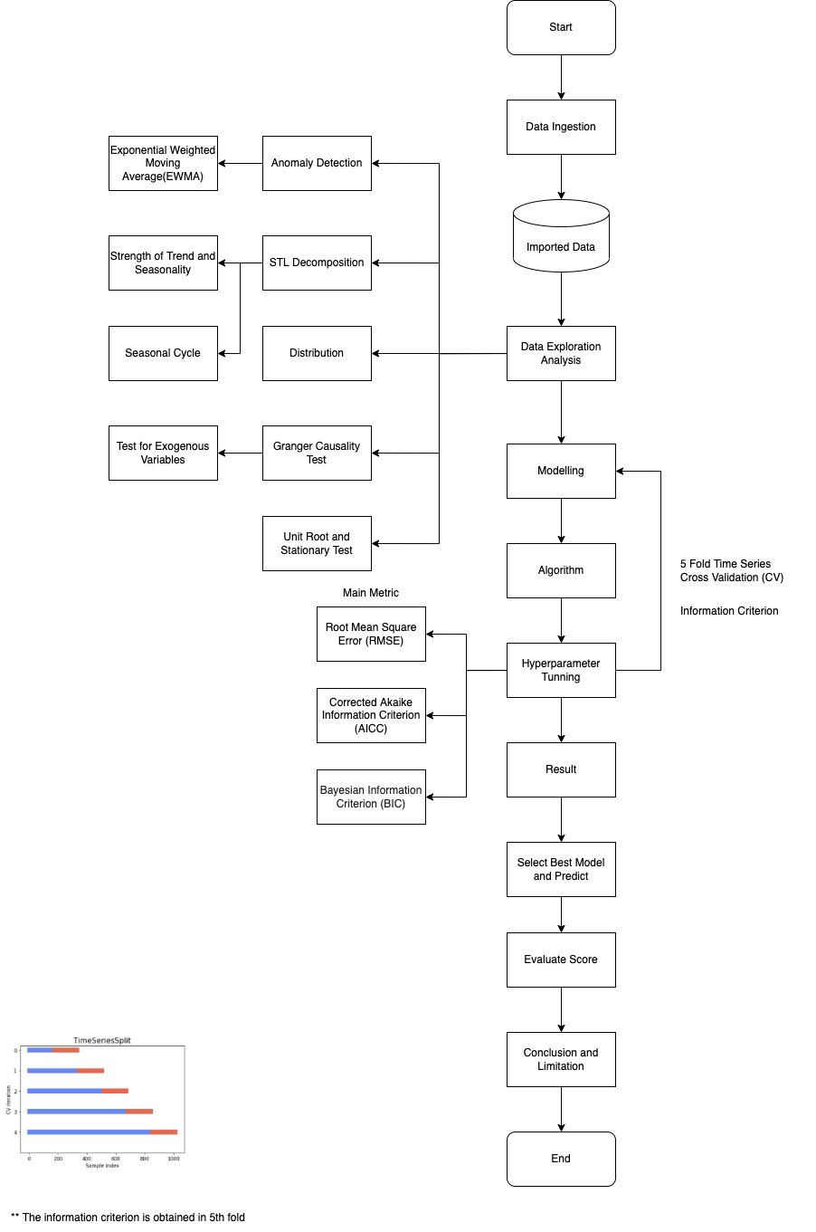
Workflow

Slide 10
Evaluation Methodology
In this paper, we experimented 5 models. A naïve forecasting baseline classifier was also added to facilitate comparison and evaluation.
Naïve Forecasting (NF)
Exponential Smoothing (ES)
Auto-Regressive Integrated Moving Average with eXogenous factors (ARIMAX)
Seasonal Auto-Regressive Integrated Moving Average with eXogenous factors (SARIMAX)
Dynamic Factors (DF)
Vector Auto-Regressive Moving Average with eXogenous factors (VARMAX)
In the experiment, the root mean square error (RMSE) is our main scoring metric
The corrected Akaike information criterion(AICC) and Bayesian information criterion(BIC) will serve as sub-metric in the evaluation.
5-fold time series cross validation will be used together with the information criteria to further evaluate the model.

Slide 11
Optimization
Grid Search CV
In the experiment, Grid Search CV was created and used in selection of the order and seasonal order*.
Auto Correlation Plot
The ACF and PACF plot was used together to better evaluate the order and the seasonal order.
Diagnosis and Residual Plot
The diagnosis and residual plot is applied to further access the performance of model.
* When applicable

Slide 12
Results and Discussion
The table below shows the performance of all model used in experiment.
Experiment Result
Name | Gas | Training | CV | AICC | BIC
 |  | RMSE | RMSE
NF | CO | 0 | 289.48803 | NA | NA
 | NO2 | 0 | 280.85473
 | O3 | 0 | 352.41701
 | HC | 0 | 252.85296
ES | CO | 160.04575 | 201.99180 | 2782.30348 | 2813.81400
 | NO2 | 152.00947 | 182.55447 | 2770.39539 | 2801.90590
 | O3 | 181.81021 | 270.03746 | 2853.54569 | 2885.05621
 | HC | 142.44258 | 183.38840 | 2734.16357 | 2765.67409
ARIMAX | CO | 66.46117 | 123.25631 | 3114.19139 | 3139.06223
 | NO2 | 88.35335 | 148.04473 | 3341.68995 | 3370.05157
 | O3 | 131.95594 | 218.10398 | 3499.26377 | 3520.62794
 | HC | 75.08477 | 118.21494 | 3226.91124 | 3251.78208
SARIMAX | CO | 106.65033 | 106.52771 | 3163.43636 | 3185.80052
 | NO2 | 125.30030 | 167.80547 | 3336.48396 | 3361.35480
 | O3 | 162.31195 | 241.41474 | 3513.55371 | 3528.42456
SARIMAX | HC | 95.45927 | 117.31122 | 3241.74595 | 3266.61679
DF | CO | 587.71864 | 951.32542 | 2982.18470 | 3002.42463
 | NO2 | 237.36752 | 245.96620
 | O3 | 705.57671 | 1184.26896
 | HC | 523.35934 | 861.50733
VARMAX | CO | 62.91469 | 108.55392 | 2383.87786 | 2426.58849
 | NO2 | 87.43273 | 153.49475
 | O3 | 129.27513 | 212.34587
VARMAX | HC | 74.10377 | 117.94882

Slide 13
Results and Discussion
Considering both all 3 metrics, we will in cooperate the VARMAX(for predicting CO,NO2,O3) and the SARIMAX(for predicting HC) as the model that has the highest performance in predicting the 4 gas.
The VARMAX model has reach a low RMSE of 108.56,153.49,212.35 for CO,NO2,O3 gases respectively.
The SARIMAX model has reach a low RMSE of 117.31 for HC gas.

Slide 14
Final Evaluation
Now we will test our model on our unseen test data.
Kaggle’s Public Score
Upon testing our model with the unseen test data, it return an average RMSE of 151.52 and ranked 6th place.

Slide 15
Conclusion and Limitation
Conclusion
In this paper, we have explored the dataset, carried out several analysis and investigated the time series models that have the highest performance in predicting the 4 gases. We evaluated and end up with a combination of the model VARMAX(for predicting CO,NO2,O3) and the SARIMAX(for predicting HC) for prediction of gases.
Limitation
The result of this experiment has to be seen in light of some limitation.
Firstly, we have limited amount of time in carrying out the experiment.
Secondly, we only have around a year of gas data which is insufficient for a more complete analysis.

Slide 16
Acknowledgement
The completion of this experiment would not have been possible without the guidance and participation of so many people. Their contributions are sincerely appreciated.
Particularly, I would like to express my appreciation to my respected lecturer, Dr. Wilson Qiu, for his continuous support and motivation. His sincerity and patience have truly inspired me.

Slide 17
Thank You
Chen ZhuoFan (P2100746)
DAAA/FT/XX/XX
6 June 2022

